Slide 1
Seminar Report
XUE JIAN
Meguro Lab
Sep 6th

Slide 2
1984 Nagano earthquake caused landslide
On September 14, 1984, an earthquake of magnitude 6.8 (Richter) occurred at a depth of 2-3km near an active volcano, Mt. Ontake (3063 m), in the mountainous area of central Japan.
 | Matsukoshi failure | Kiyotaki failures | Ontake failure | Takigoshi failures
Total Volume(10³m³) | 290 | 100 | 36,000 | 500
Slope Angle | 17 | 10~20 | 25 | 30~50
Deposit Depth(m) | 40 | 5~10 | 100~150 | 50
The Ontake failure’s failure material turned into a gigantic debris flow and traveled the valley with a thickness of about 40-90 m at the average rate of about 20 m/s.
The material flowed down about 8.5 km along the valley and flowed into the main stream of the area, forming a vast sedimentary plain of 100-400 m wide and 30-40 m thick over a distance of about 3 km.

Slide 3
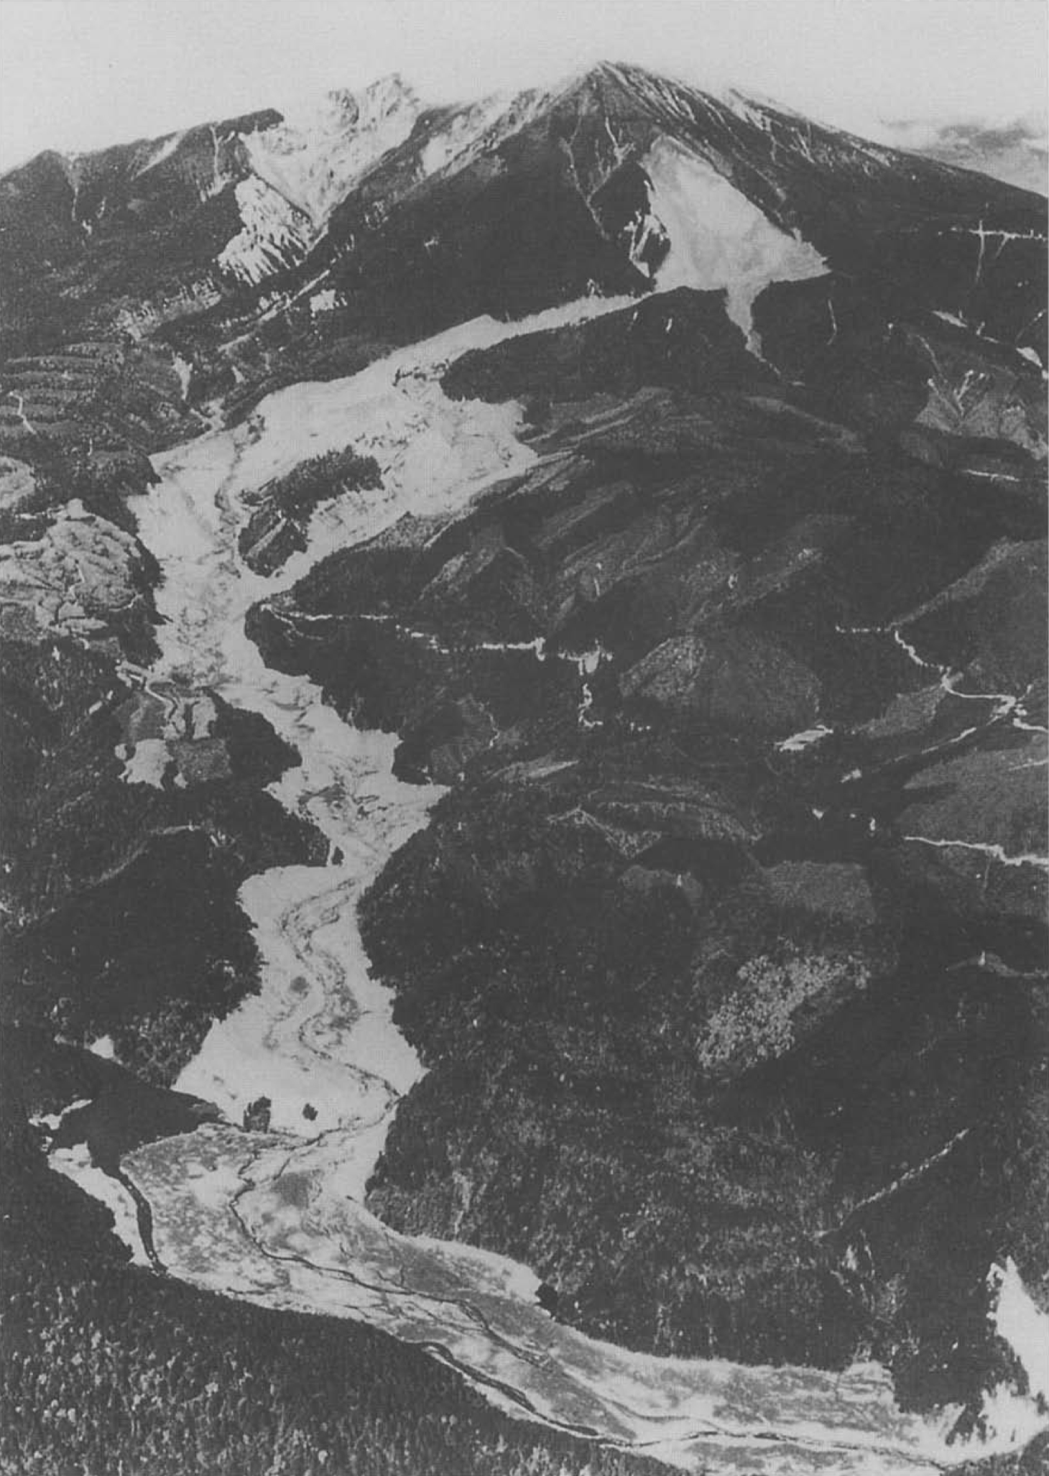
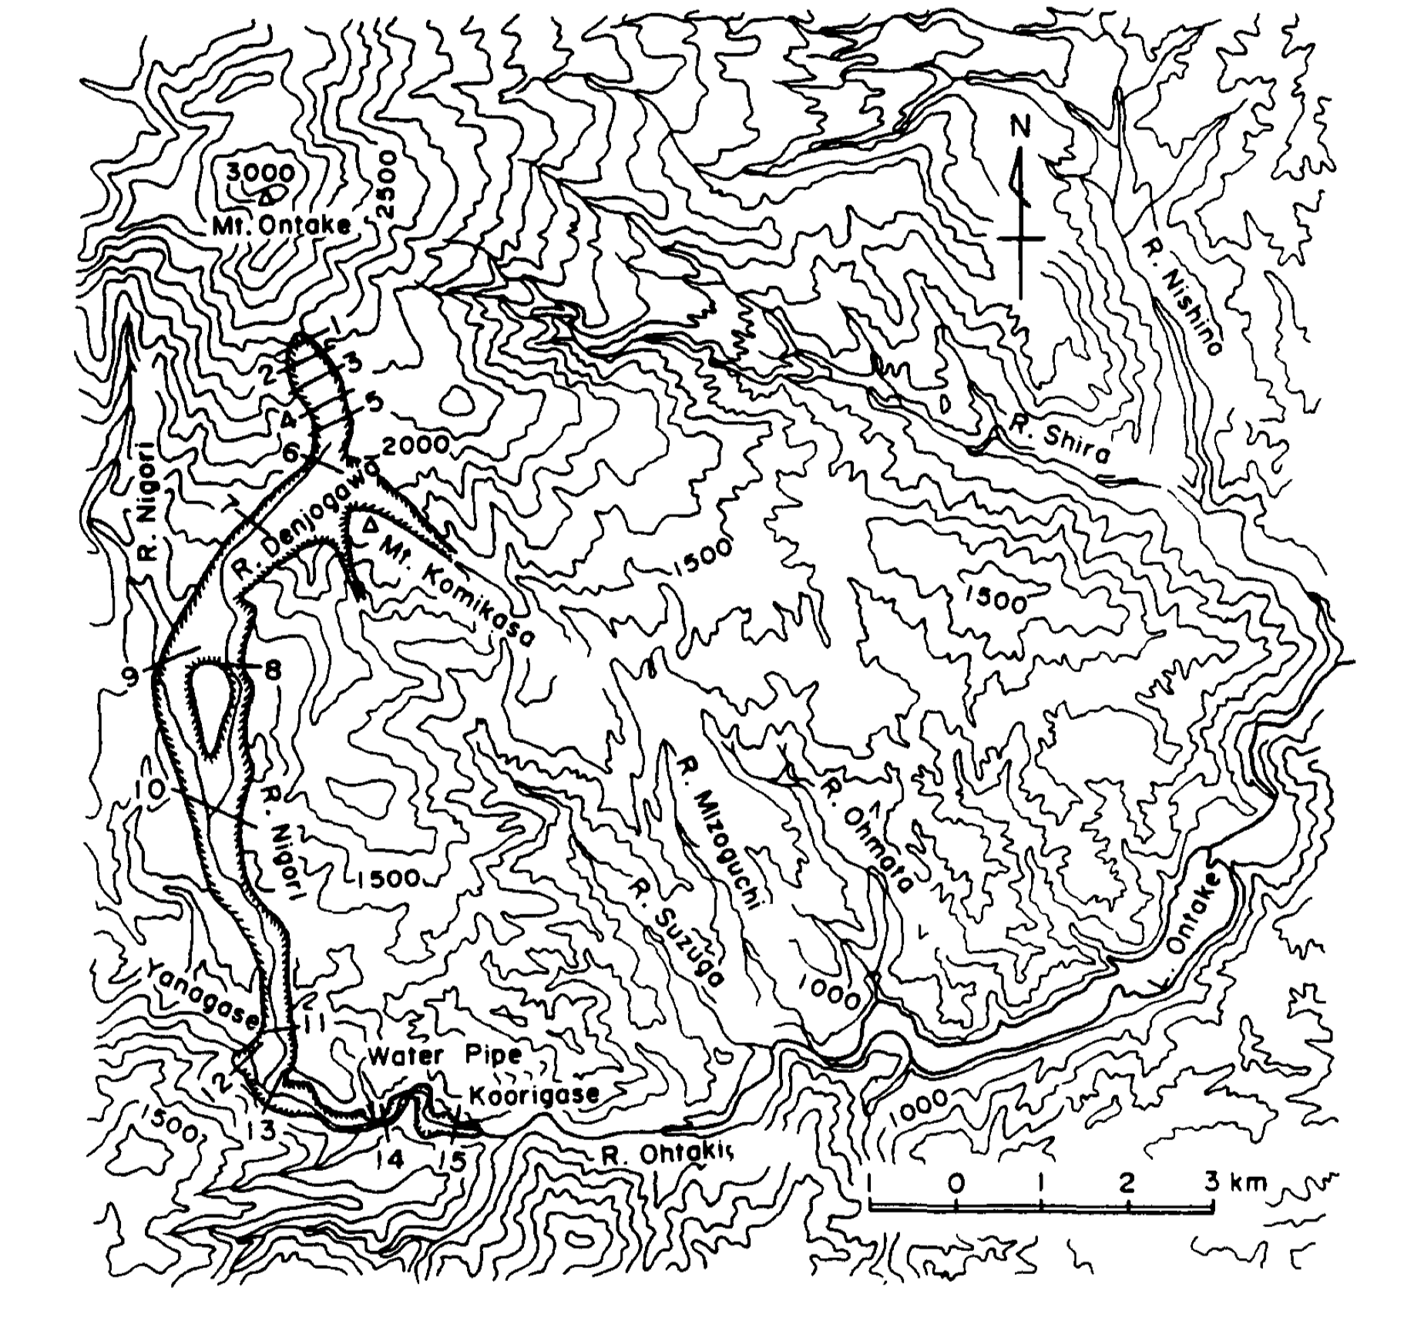
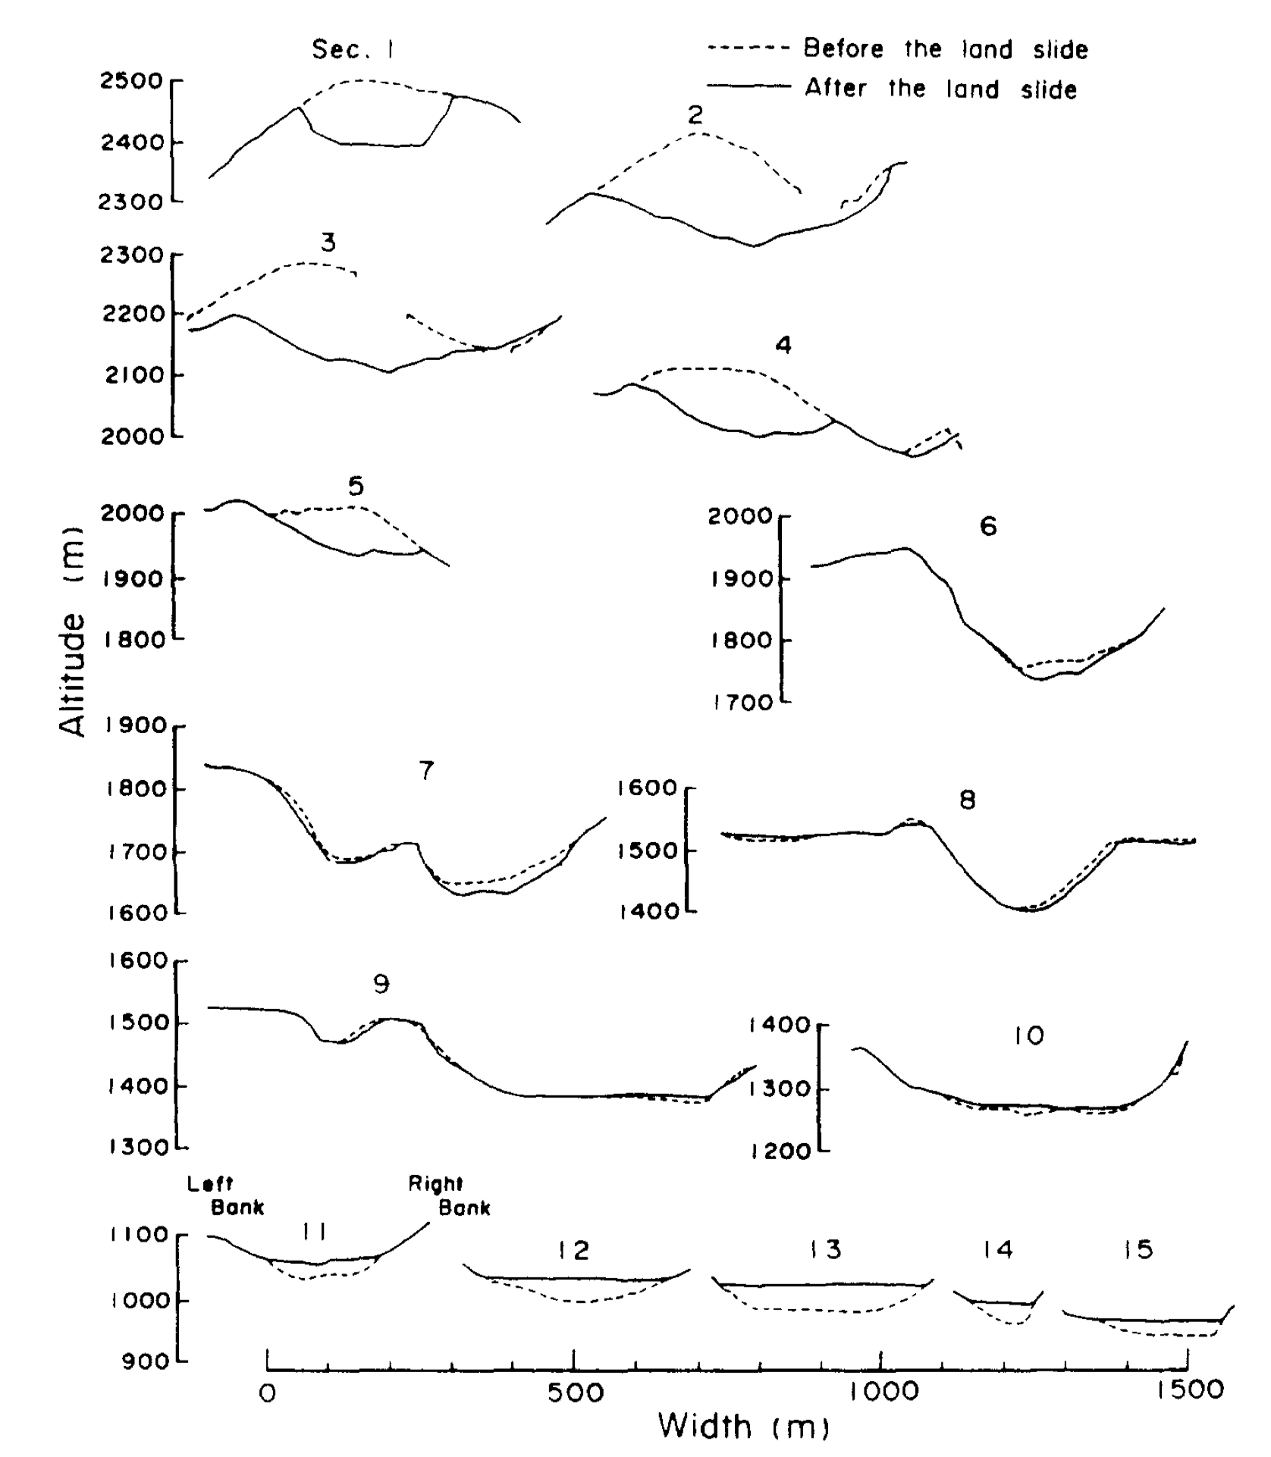
1984 Nagano earthquake caused landslide
Fig.1 Ontake-san avalanche of 1984. View north.
Sourced(Lessons from Ontake-san: A comparative analysis of debris avalanche dynamics)
Fig.2 Ontake-sanavalanchearea showingsource area (sections 1-5), main flow channel (sections 6-15) and location of overflow areas
Source(Lessons from Ontake-san: A comparative analysis of debris avalanche dynamics)
Fig.3 Cross-sections of channel for Ontake-san avalanche.
Source(Lessons from Ontake-san: A comparative analysis of debris avalanche dynamics)

Slide 4
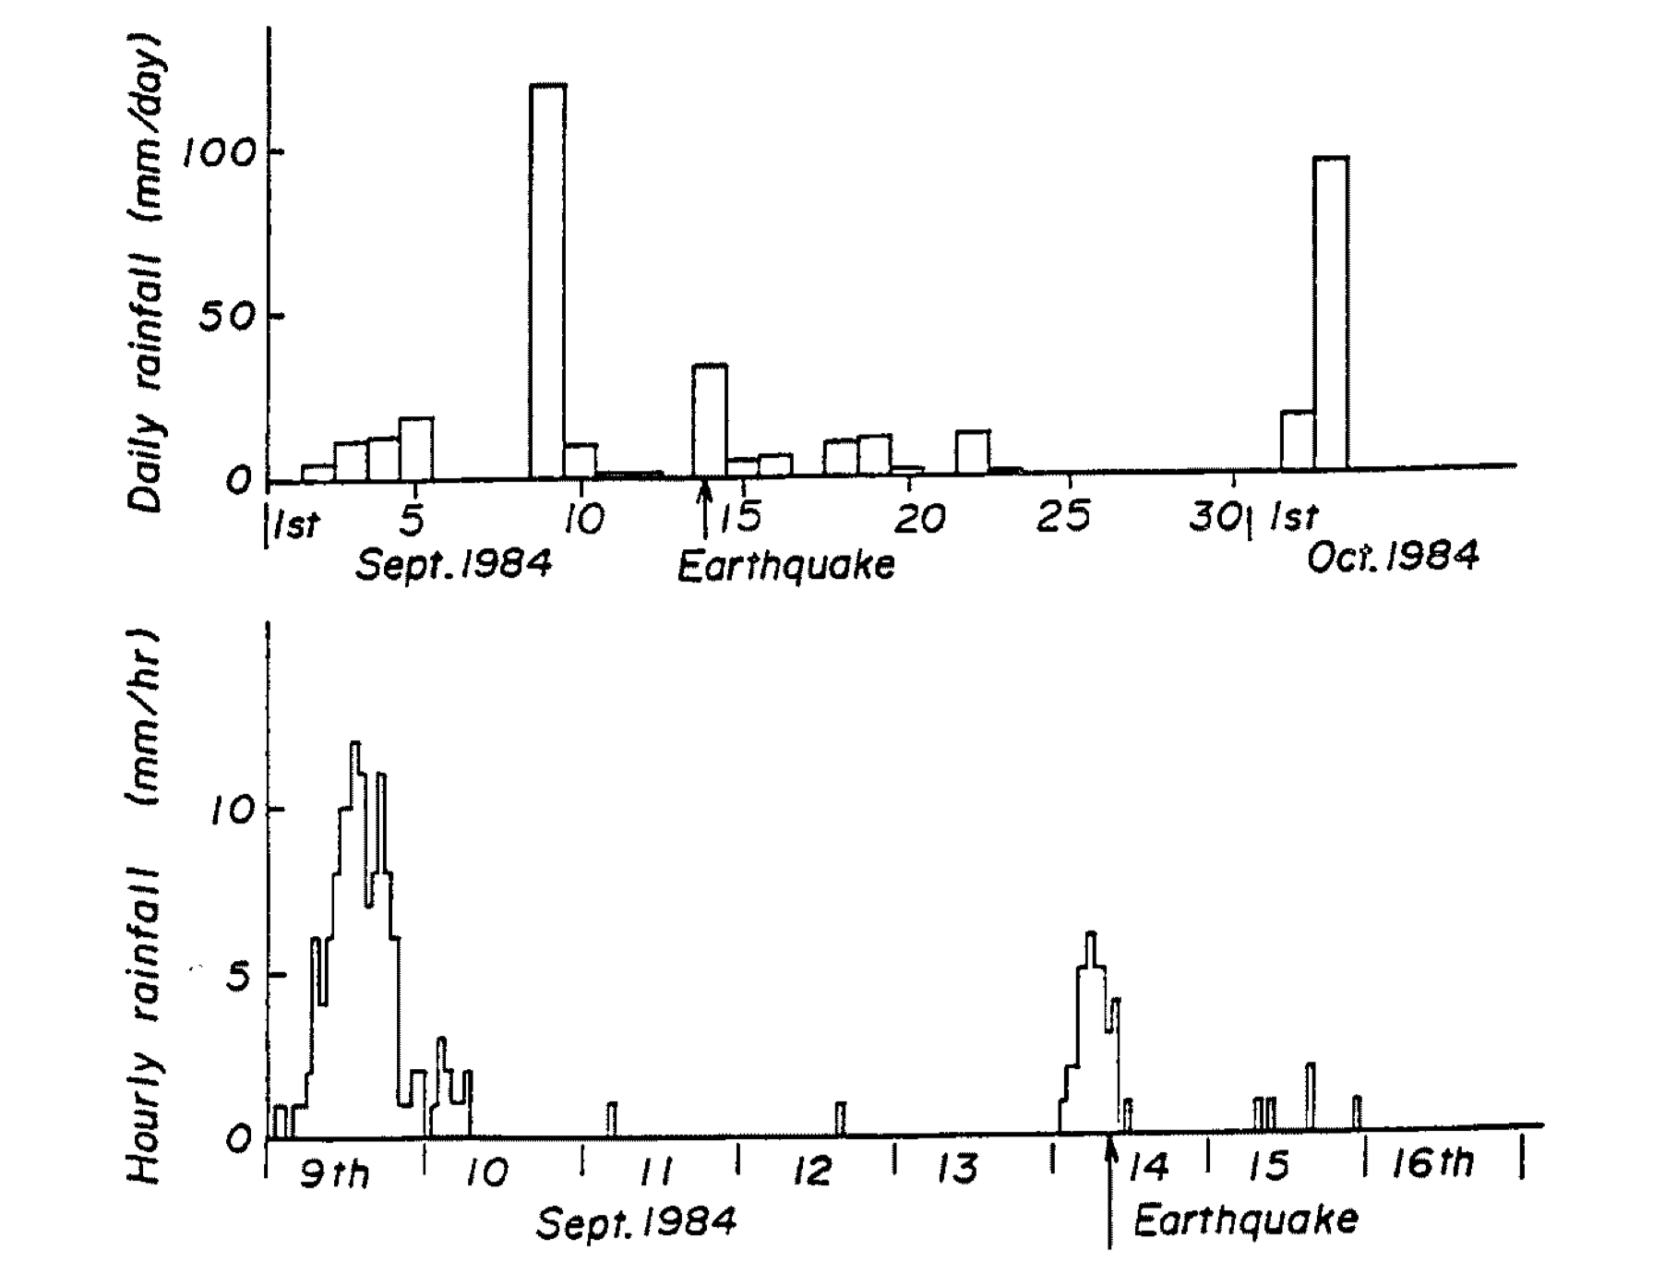
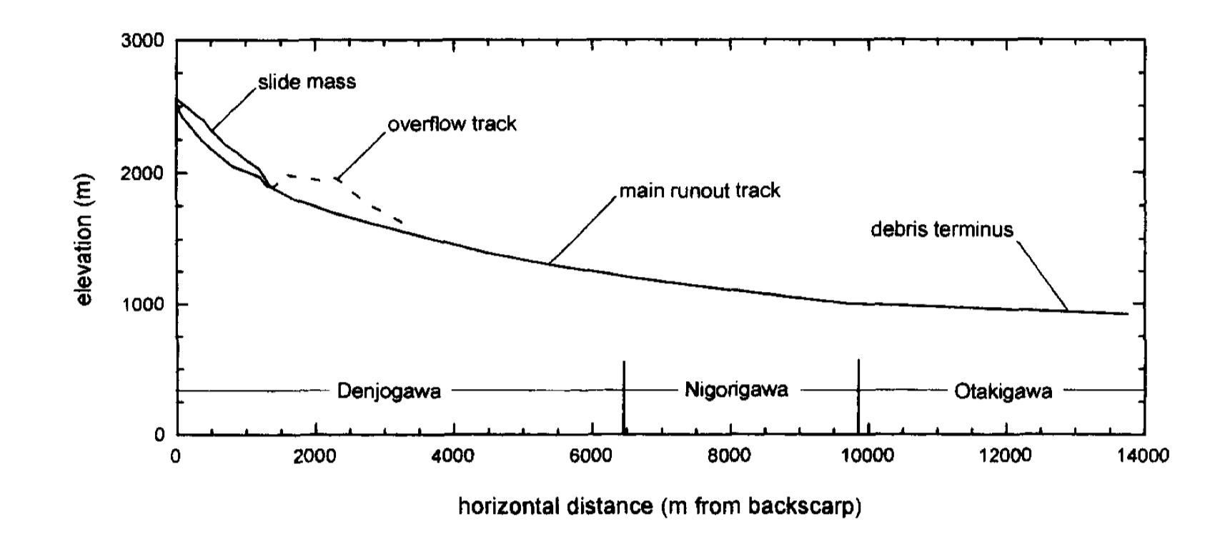
1984 Nagano earthquake caused landslide
Fig.4 Daily rainfall (top )and hourly rainfall (bottom )during a period including the debris avalanche recorded at the rain station.
Sourced < Restoration Of Motion of Debris Avalanche At Mt Ontake In 1984 And Some Discussions on Its Moving State >
Fig.5 Ontake-san a~calanche runout track profile. Dashed line indicates profile for 'First Overflow Area’.
Sourced <Lessons from Ontake-san: A comparative analysis of debris avalanche dynamics>

Slide 5

1984 Nagano earthquake caused landslide

Slide 6

1984 Nagano earthquake caused landslide

Slide 7
1984 Nagano earthquake caused landslide
20
10
0
50
100
150
200
250

Slide 8
1984 Nagano earthquake caused landslide
Height(cm)
20
10
0
50
100
150
200
250
Length(cm)

Slide 9
1984 Nagano earthquake caused landslide
Height(cm)
20
10
0
50
100
150
200
250
Length(cm)

Slide 10

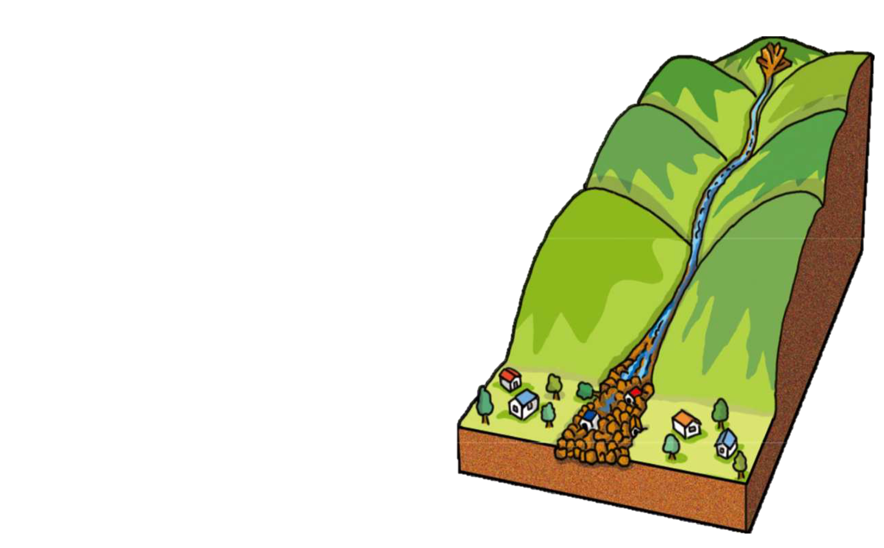
Landslide and Debris Flow
 | Land slide | Debris Flow
Caused by | earthquakes, storms, volcanic eruptions, fire and human modification of land | intense rainfall, runoff, or rapid snowmelt, transfer from land slide. wildfire burns a slope increases the chance of debris flows
Consist of | rock, earth or debris | rock, earth and other debris saturated with water.
Position | Steep slopes and areas at the bottom of slopes or canyons; Slopes that have been altered for construction of buildings and roads; Channels along a stream or river; and Areas where surface runoff is directed.
Notes:
disturbances in the natural stability of a slope
a debris flow can start on a dry slope after only a few minutes of intense rain. “Intense” rain means a burst of rain at a fast rate, about half an inch in an hour. With debris flows, the rain rate matters more than total rainfall,
because of the properties of saturated water, we can treat the mixture of rock earth and other debris with saturated water as a non newtonian fluid and describe it with bingham fluid. I also saw some paper call debris flow a fast landslide.

